Slide 1
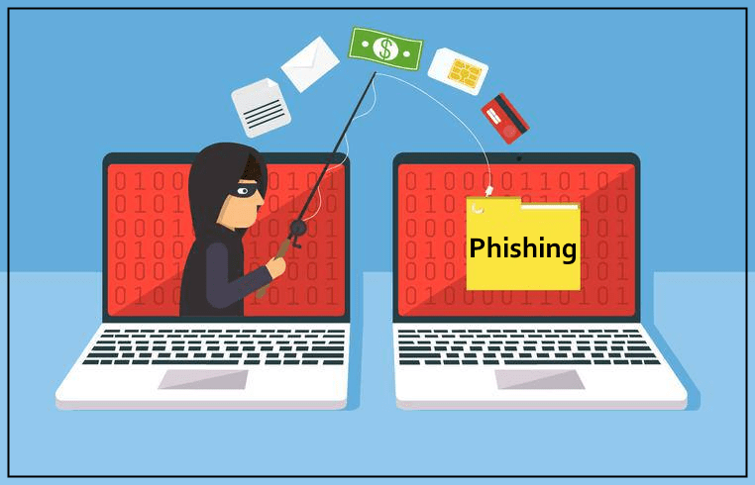
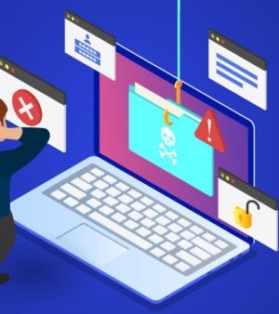
PHISHING ATTACKS
.

Slide 2
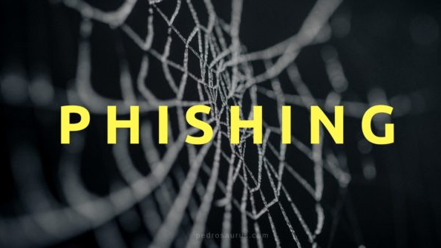
"Caught in the Net: How Phishing Attacks Are Hooking Victims Worldwide"
In today’s digital age, phishing attacks have become a prevalent and sophisticated threat, ensnaring individuals and organizations in their deceptive web. These cybercrimes involve fraudulently obtaining sensitive information by masquerading as trustworthy entities, leading to significant financial and personal data losses.

Slide 3
Definition Of Phishing
Phishing attacks are a type of cybercrime where attackers impersonate legitimate institutions or individuals to deceive people into providing sensitive information, such as passwords, credit card numbers, and personal details. These attacks can occur through emails, websites, social media, or even phone calls.

Slide 4
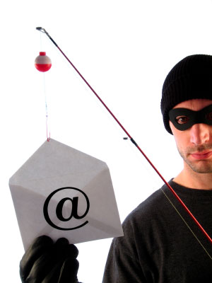
Email Phishing
The most common form, where attackers send fraudulent emails that appear to come from a reputable source, such as a bank or an online service.
T

Slide 5
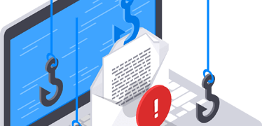
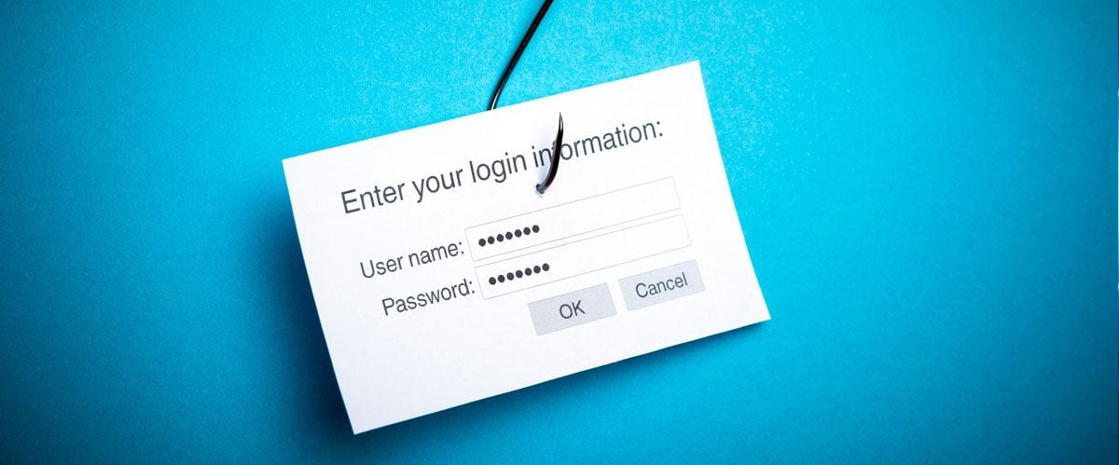
Recognizing Phishing Emails
Check the sender's email address.
Look for generic greetings.
Be cautious of urgent or threatening language.
Inspect links before clicking.
.

Slide 6
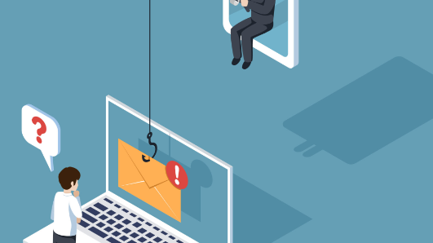
Examples of Phishing Emails
Email from a fake financial institution.
Fake invoice or order confirmation.
Emails with malicious attachments or links.

Slide 7
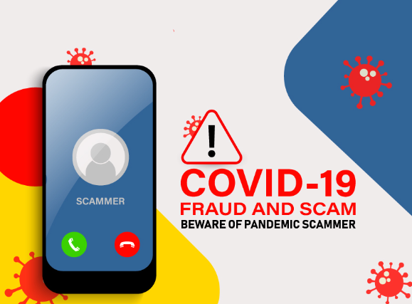
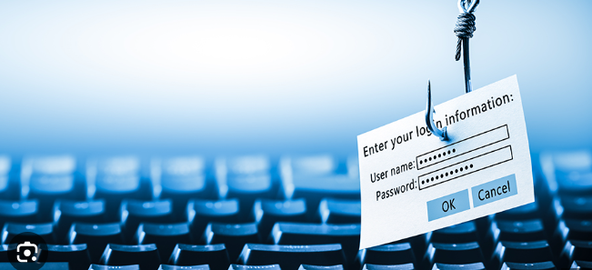
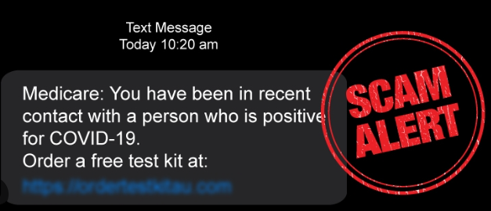
Recent High-Profile Phishing Attacks
COVID-19 Vaccine Scams:
With the global focus on vaccination, phishing emails posing as health authorities have surged.
These emails offer fake vaccination appointments or incentives, leading to data theft.
Remote Work Exploits:
As remote work becomes the norm, phishing attacks targeting remote workers have increased.
Fake emails from collaboration tools like Zoom and Microsoft Teams attempt to steal login credentials.
Tax Season Scams:
During tax season, phishing emails claiming to be from tax authorities like the IRS are common.
These emails inform recipients of tax refunds or audits, leading them to malicious websites.

Slide 8
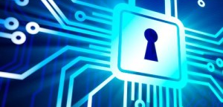
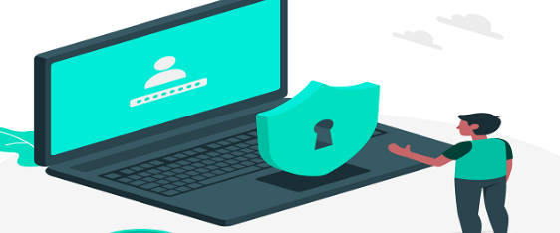
Identifying Phishing Websites
Check the URL for misspellings or extra characters.
Look for HTTPS in the URL.
Be cautious of pop-ups asking for personal information.

Slide 9


Steps to Take if Phished
Do not click any links or download attachments.
Report the email to your IT department.
Notify Relevant Parties: Inform your bank, email provider, or any other relevant organization about the breach.
Change any compromised passwords immediately.

Slide 10
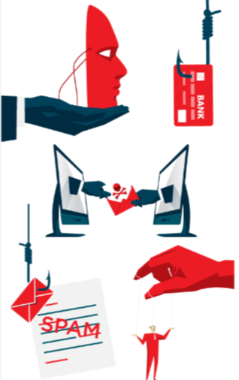
Best Practices to Avoid Phishing
Use strong, unique passwords.
Enable multi-factor authentication.
Regularly update software and security patches.
Be cautious with unsolicited emails.
Check for SSL Certificates: Ensure the website you are visiting
uses HTTPS, which indicates it has a secure connection.

Slide 11
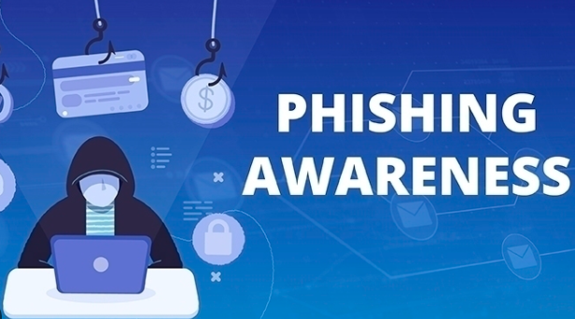
Conclusion
Stay vigilant and educate yourself about phishing tactics. Awareness is key to preventing these types of cyber attacks.
you can better protect yourself and others from falling victim to these cyber threats.

Slide 12
Some references
THANK YOU
I HOPE TO LIKE IT
Written and designed by Youssef Ahmed Moneir
https://www.cisco.com/c/en/us/products/security/email-security/what-is-phishing.html cisco
https://www.microsoft.com/en-us/security/business/security-101/what-is-phishing#dangers-of-phishing-emails microsoft
https://www.bbc.co.uk/news/uk-england-kent-55909448 BBC News

